Slide 1
Empirical Evaluations of Agentic LLM Systems

Slide 2
Introduction to Agentic LLM Systems
Q - What is an Agentic LLM System?
A - LLMs as Generative systems are also capable of solving complex tasks by interacting with their environment.
Eg: Data Analysis, Multimodal Analysis, creative writing etc..
Key components of Agentic LLM Systems:
Planning
Implicit – LLM-as-a-Judge
Explicit – CoT, ToT, ReAct approaches.
Memory
Short-term: Conversation History.
Long-term: Personal preferences.
RAG: Domain Knowledge incorporation
Tools/Function Calls
Libraries: Data processing and visualization
APIs: Calculator, Search etc..
Control Flow
Error Handling
Intermediate steps Tracing and evaluation

Slide 3

Problem Statement
High Level overview:
Existing Frameworks: Langchain, Auto-GPT etc., provide frameworks for planning, memory, Tools calling, Error Handling for Agentic applications.
Lack of adequate empirical evaluations on best practices of these cases for real-world use cases.
Moreover, effective tracing of intermediate steps in Agentic workflows aids in building Trustworthy Agentic AI systems.

Slide 4
Limitations of Prior Work
Static Tool Routing: No dynamic selection or chaining of tools
Limited Memory Management: Unassessed impact of context retention on cost & efficiency
Coarse Evaluation Metrics:
Broad success measures hide failures in tool choice & reasoning steps
Cost vs. Accuracy Bias:
Overfocus on accuracy drives complex, expensive agents; strategies like warming/escalation remain underused
Prompting Strategies:
Need guidance on when to use CoT, ToT, zero-/few-shot, or ReAct approaches
Hyperparameter Tuning:
Application-specific calibration of temperature, seed, top-p, output count
Lack of Multimodality:
Few agentic systems integrate vision, audio, or other data types

Slide 5
Project Aim:
“Empirically evaluate structured and unstructured data workflows to address the existing limitations and drive more robust, efficient LLM agentic applications.”

Slide 6
Solution Challenges
Dynamic Tool handling
Diversity of Planning architectures
Context-aware memory retrieval
Real Time cost-tracking & Optimization

Slide 7
General Framework/approach:
Modular Agentic Framework:
User Interaction Layer: handles input/output interfaces.
Planning & Reasoning Layer: strategy generation and decision-making using prompt engineering, CoT, ToT, ReAct, pruning non-viable paths.
Tracer/Evaluator: Open Telemetry - Logs intermediate steps, tool calls, latencies
Execution & Tooling Layer: Dynamic Tool calling, JSON Parsing.
Adaptive memory management: Handling context between tool calls, storing conversation history, Domain knowledge retrieval.
Error Handling Unit: catches and recovers from failures using retries.
Output Parser: formats and post-processes results

Slide 8
Empirical Evaluations
1. Data Analysis from static CSV file
2. Multimodal Analysis of Annual Report
3. Tree of Thought Analysis for Creative Writing

Slide 9
Evaluation 1: Baltimore City Salaries Dataset
Source: csv file, InfiAgent Benchmark
Implementation:
3 Tools:
Database Lookup
Data Analysis
Data visualization
User
Router w/ function calling
Prompt
Holistic Evaluation using frameworks
Output

Slide 10
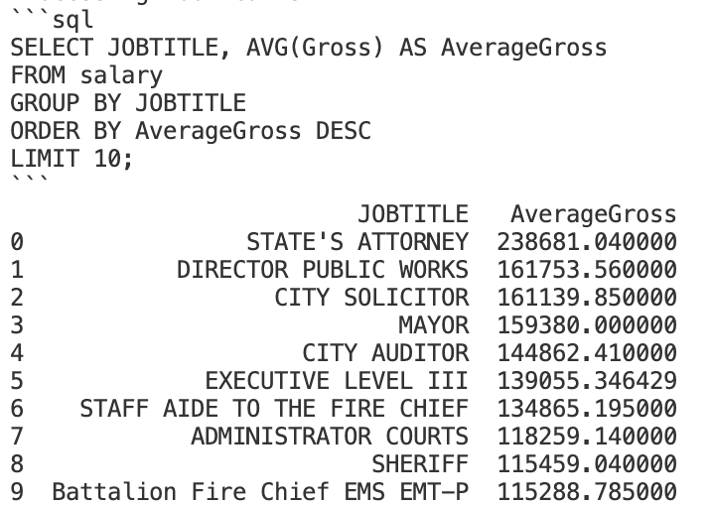
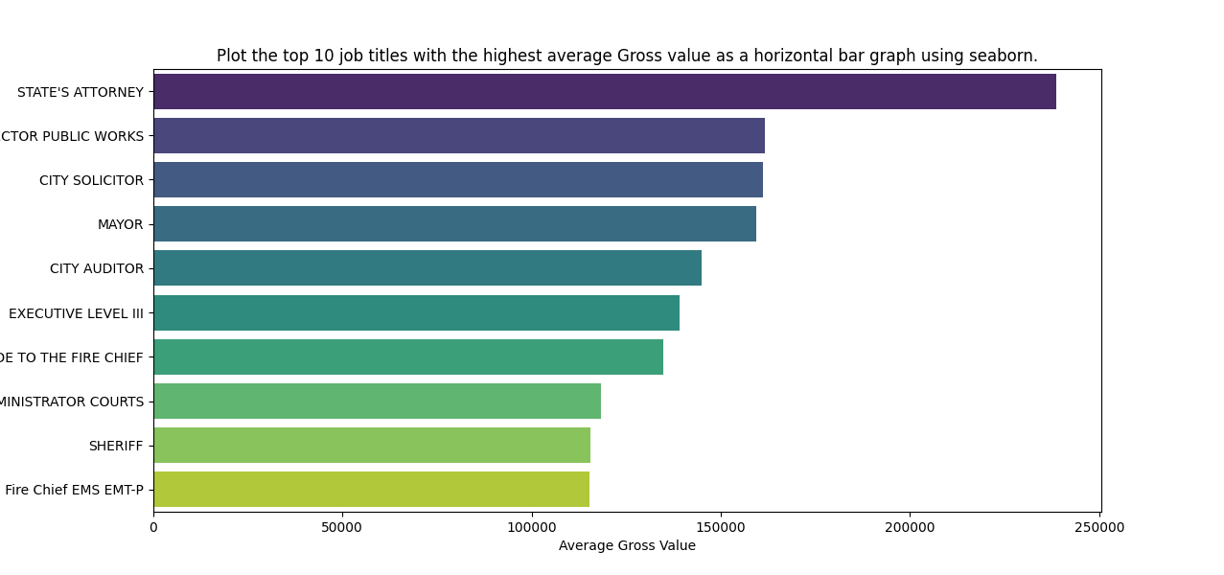
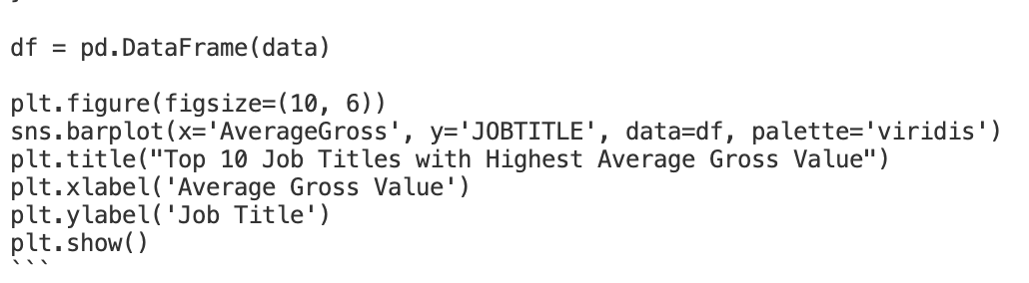
Results
Single Prompt for Agentic Workflow:
“Determine which job titles have the highest average Gross value in the given dataset and provide top 10 ranks overview and plot them as horizontal bar graph using seaborn.”
Output:
Tool 1&2: SQL Query Generation and Data Retrieval
Tool 3: Graph plotting

Slide 11
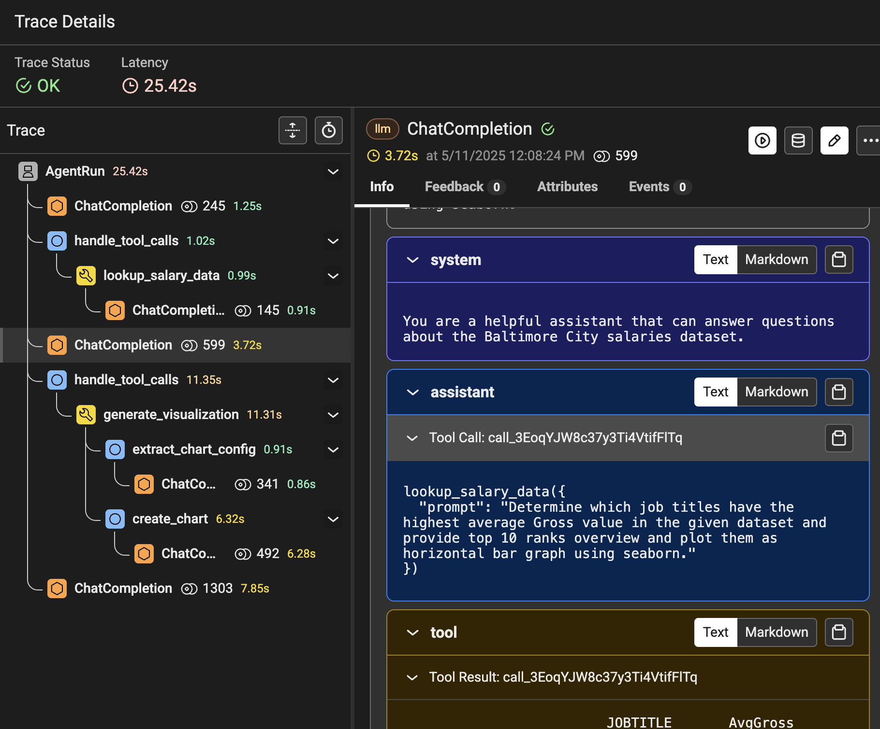
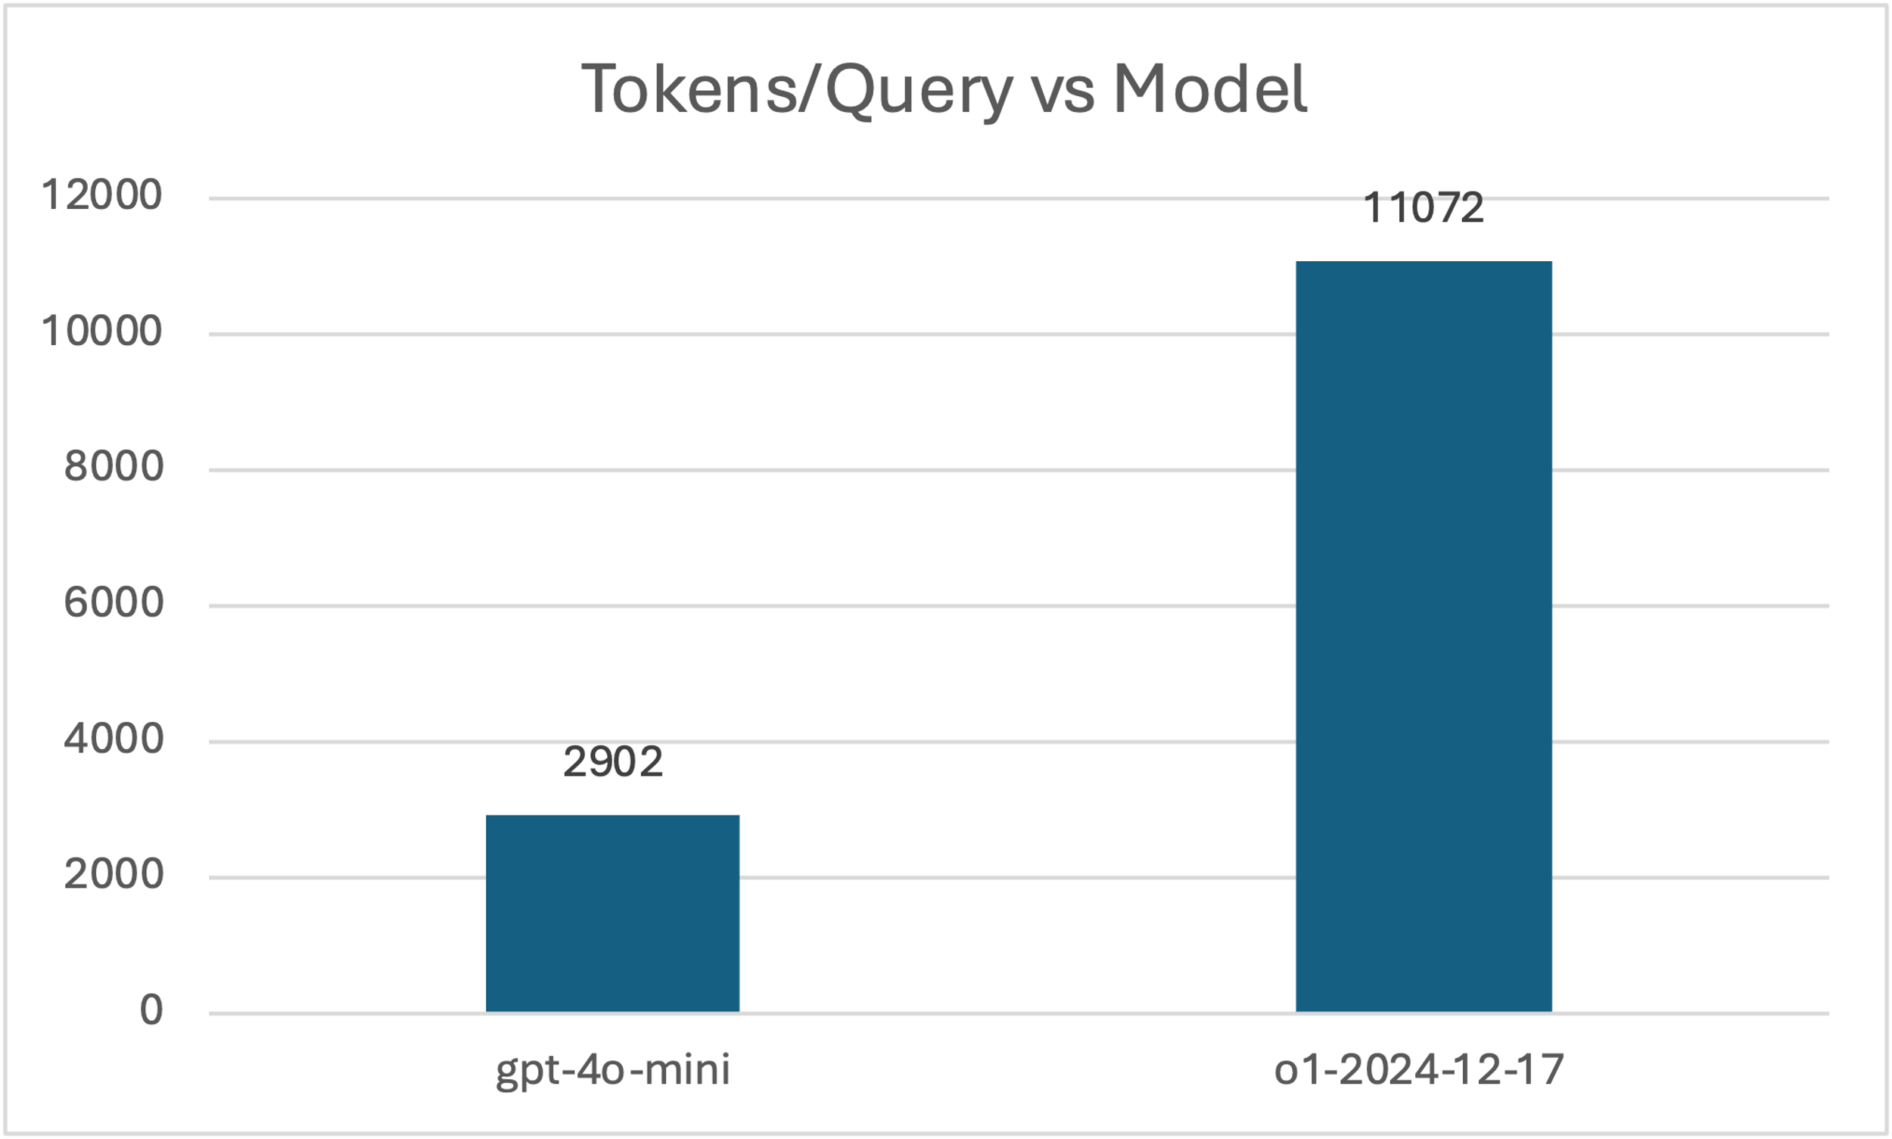
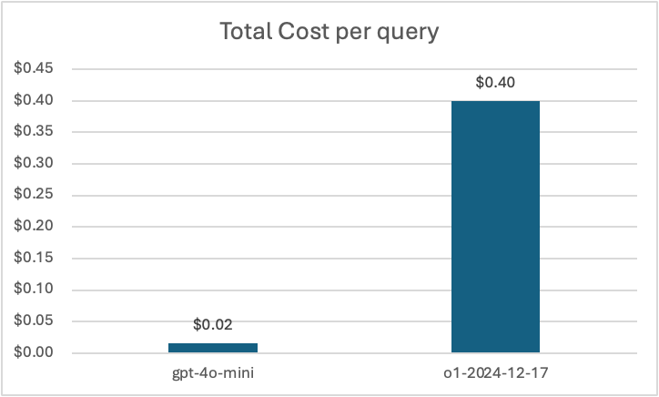
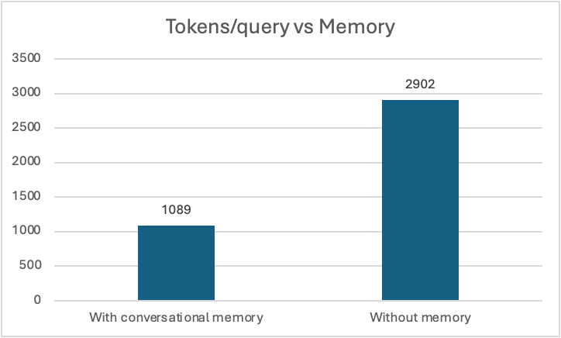
Insights:
We were able to demonstrate:
Automated LLM tool routing: enables flexible, agentic workflows, with intermediate steps tracing.
Model matters: Using GPT-4o-mini achieved equal accuracy with 4× fewer tokens and ~50× lower cost per query when compared to o1 model of OpenAI.
Conversational memory: boosts efficiency by reusing prior context without reprocessing all data for further queries.
Prompting: CoT offers context management between automated Tool calls while Tree of Thought prompting offered minimal benefit for structured data analysis.

Slide 12
Evaluation 2: Multimodal Analysis
Source: LTIMindtree Annual Report(2023-24)
User Query
Multimodal Retriever
RAG Generator + CoT + ToT + ReAct Framework
Output
ChromaDB Vector Database
Embeddings Processor
Text Files & Images
Source Document

Slide 13
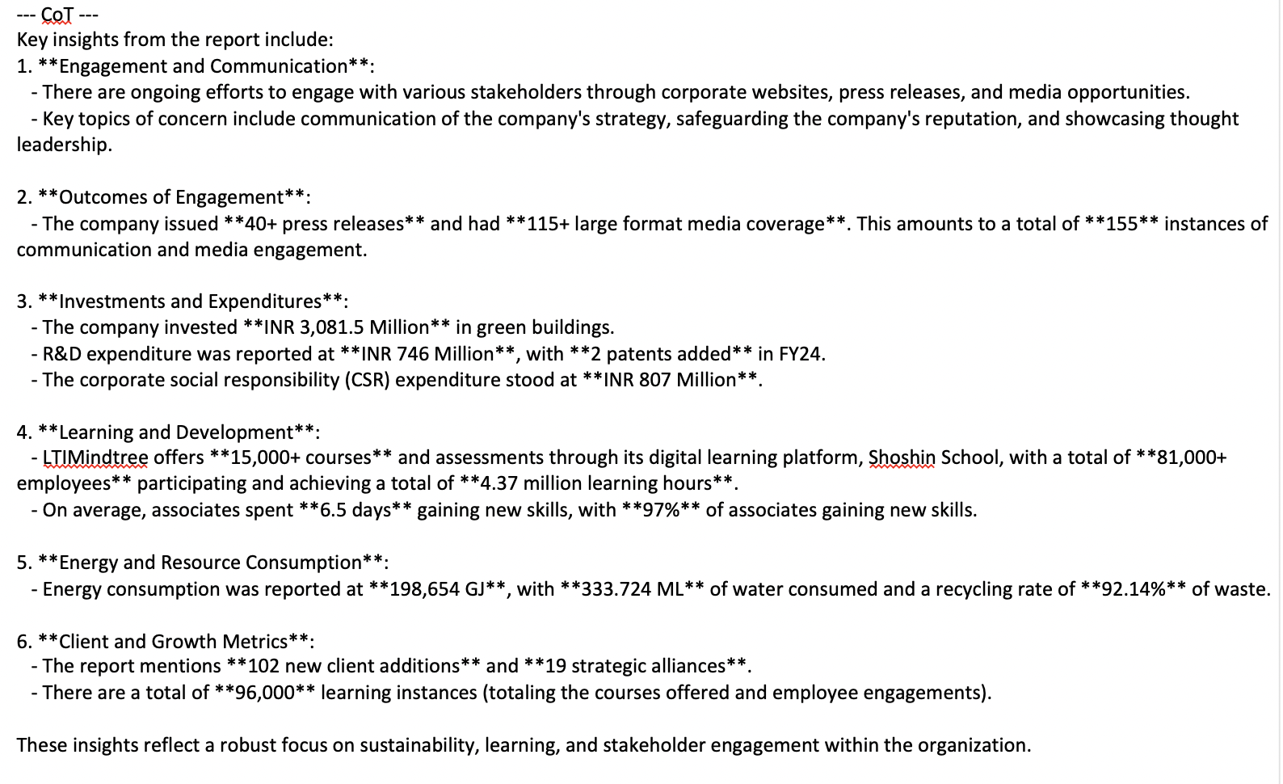
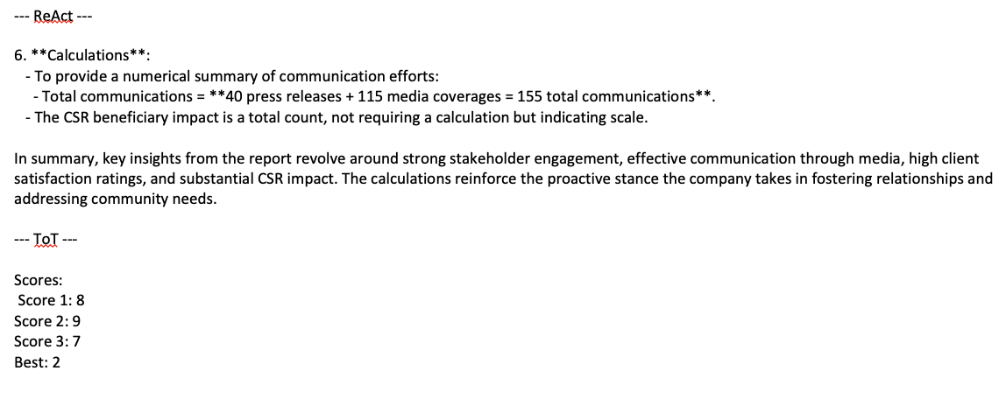
Results:
Query: "What are key insights from the report? Include any calculations."

Slide 14
Insights:
We have successfully demonstrated:
Data Retrieval for unstructured document such as annual report which has multimodal data such as Text, Tables, images and process it through Vector embeddings, though limited by efficiency of data extraction by tools.
Compared different planning approaches such as ReAct, CoT, ToT and found ToT to be less helpful for static data, while performing better in analysis of subjective queries.
Experimented with Hyperparameters such as temperature, top_p, seed value. While subjective questions showed considerable variation between different approaches, but simple data retrieval-based questions showed minimal variance.

Slide 15
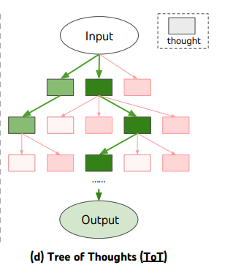
Evaluation 3: Creative writing
Approach: ToT based planning at each intermediate step to prune non-viable paths based on heuristic functions.
Results:
High relevance for ToT based planning in this task where the outputs were highly diverse tuned based on
pruning approach
hyperparameters and
heuristic functions.

Slide 16
Limitations of our approach:
Multi‐Source Data: Extend evaluation to workflows spanning multiple file sources
Enhanced Agency: Integrate dynamic discovery beyond pre-defined tools for true autonomy
Human-in-the-Loop: Incorporate expert review to validate agent outputs
Model Fine-Tuning: Tailor models on domain-specific data for improved performance
Retrieval Trade-Offs: Balance Graph-RAG complexity vs. vector-embedding simplicity; leverage frameworks like LangChain
Robust Error Handling: Develop strategies for unpredictable tool-call failures
Hallucination & Bias: Research trustworthy reasoning models and bias mitigation techniques

Slide 17
Thank You

